Slide 1
Jeshore Final Presentation
Skyler Bolton, Nautishay Cain, Joel Garner
Alex Hamilton, Jackson Hyde, Kolby Isenburg
Tay Richardson, Hrishikesh Vikram
Notes:
Ginyu Force

Slide 2
Overall Goal
Java/JavaFX application that utilizes multiple design patterns (adapter, singleton, visitor, and composite) that executes activities of a virtual drone on a virtual farm with a UI that allows the user to select a variety of functions at any time.
Stores list of Items and Item Containers on the farm.
Add/change different attributes regarding the items/item containers.
Virtual drone can visit different items/item containers.
Virtual drone can scan the entire farm.
Connecting to a real world Tello Quadcopter drone with the same UI that executes different kinds of physical drone functionalities.
Drone can visit physical items place within a 32x24 foot area.
Drone can scan a 32x24 foot area.
Notes:
Jackson

Slide 3
Problems being solved
Creating a coherent and easy to use user interface for the farmer to be able to operate the drone that will make farm management easier.
Before any drone can solve problems on the farm, it must be connected to first and foremost. Connecting to the physical drone was an important issue to be solved.
Notes:
Kolby

Slide 4
Team Organization
Flexible team structure based on majority rule
Decisions are made as a group in regards to communication and general group actions
For individual assignments, roles are listed and accepted via volunteering
Group discussions are held when issues arise in team communication
Team communication primarily held on Discord in a group server
Notes:
Joel

Slide 5
Requirements
Process for collecting requirements
Instructions provided by multiple assignments
Team meetings that allowed us to specify implementations of requirements
How work was divided and integrated
Project requirements were split into multiple parts and we had people sign up for certain parts of the assignment that they were comfortable doing.
Notes:
Nautishay

Slide 6
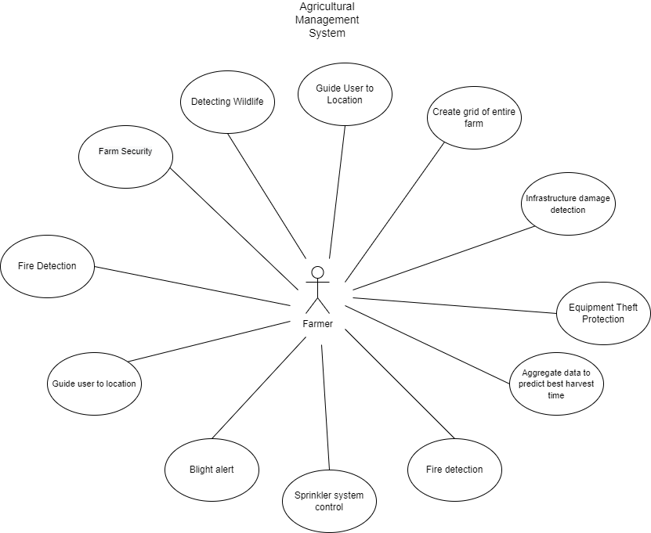
Requirements - Use Case Diagram
Notes:
Nautishay - extended cut

Slide 7
Specifications
Process for turning requirements into specifications
Created detailed uses cases and UML diagrams
Class Diagrams
State Chart Diagrams
Sequence Diagrams
How work was divided and integrated
Project specifications were split into multiple parts and we had people sign up for certain parts of the assignment that they were comfortable doing.
Notes:
Vikram

Slide 8
Design and Implementation
Team meeting to determine the exact requirements for the design.
Divided the assignment into multiple parts.
Created a list of the different parts of the assignment and had people sign up.
Different members of the group would get together and combine what they had to create a single implementation.
Notes:
Tay

Slide 9
Testing
Simulation
Testing each aspect of the dashboard and simulation to meet the requirements and not exceed the bounds of normal use.
Examples:
Item not exceeding the size of its container.
Not exceeding the bounds of the farm.
Drone visiting items and scanning the farm correctly.
Tello Drone
Went to a park and mapped out a 32x24 foot area to test the drone’s scanning and visiting functionalities.
Notes:
Skyler

Slide 10
Conclusion
Real life utility of design patterns
Real life implementation of design patterns
How to create a UI with JavaFX
How to create different UML diagrams and understanding their utility in large projects.
Communication and teamwork skills
Notes:
Alex

